Slide 1
By ONECompany

Slide 2


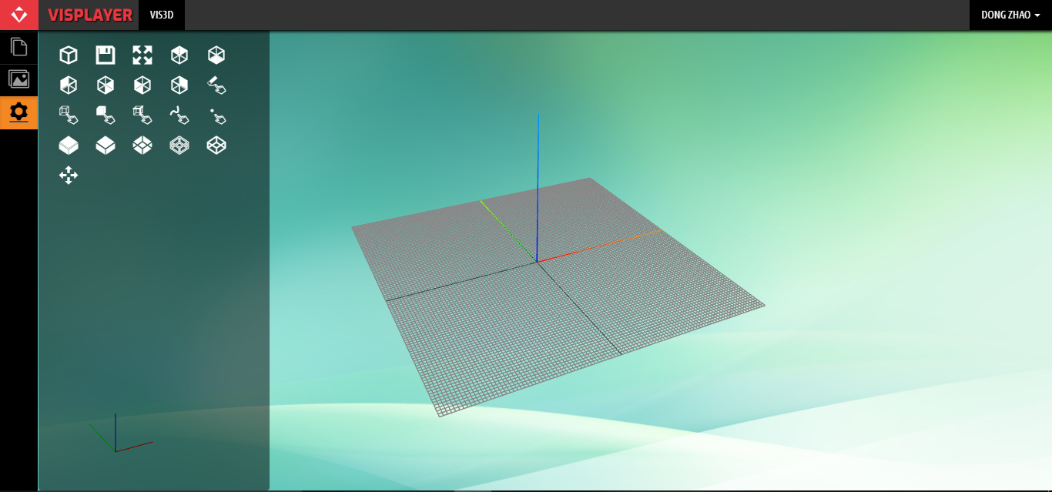

Login via web

Slide 3
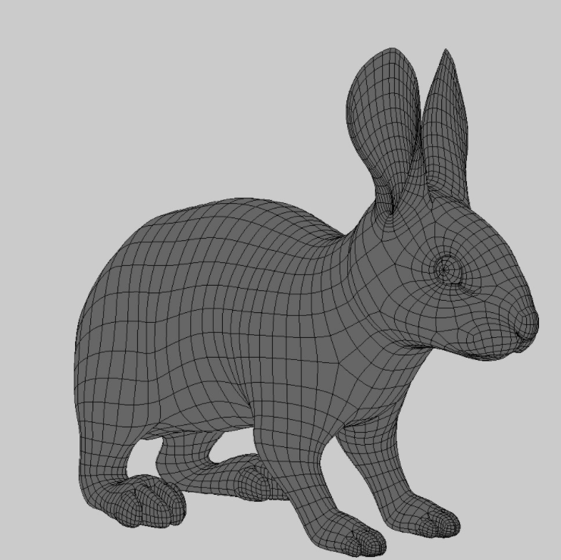
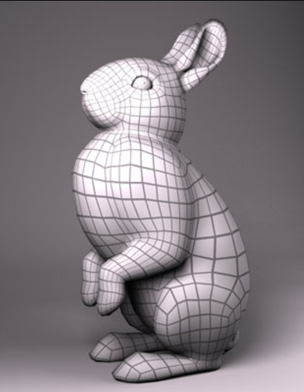
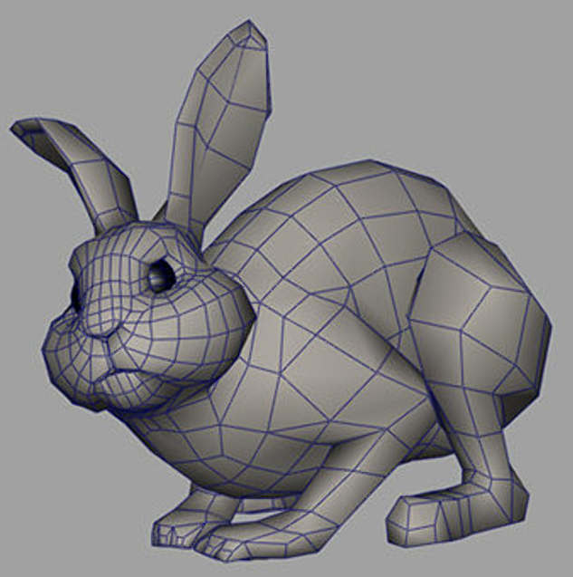
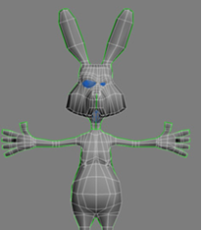
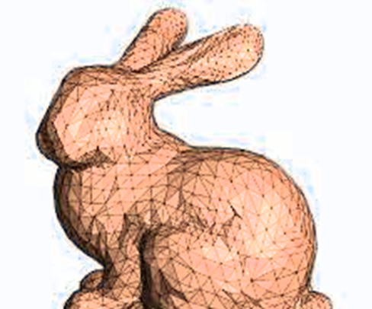
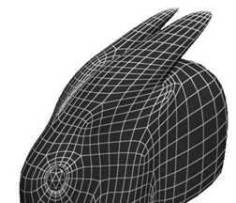
Searching for 3D Models

Slide 4
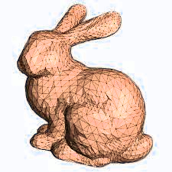
Choose 3D model

Slide 5
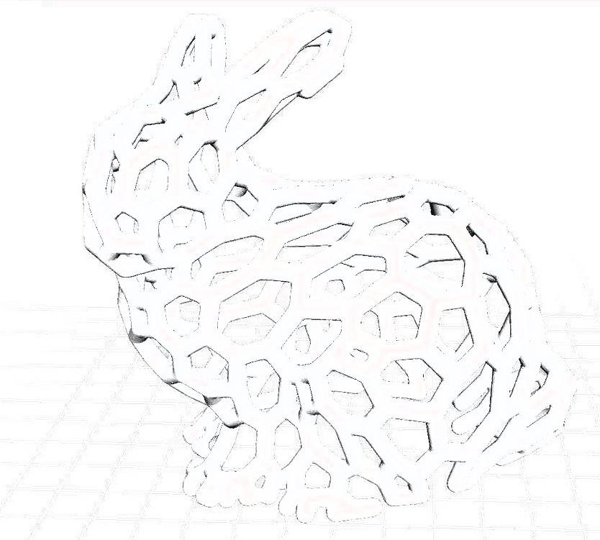
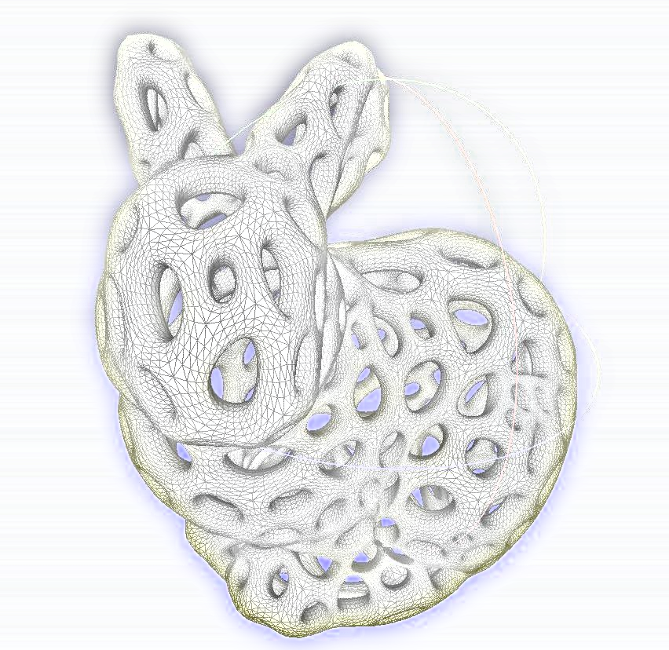
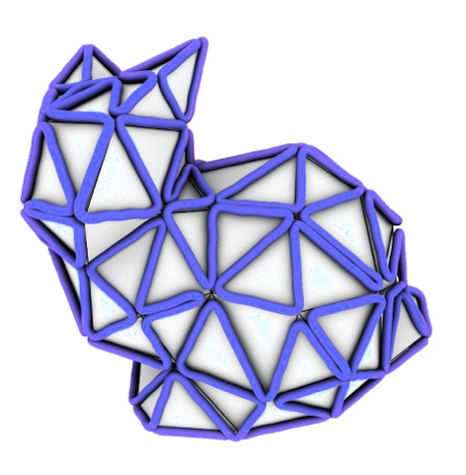



Apply filters
...
...

Slide 6
Editing and printing 3D Model

Slide 7
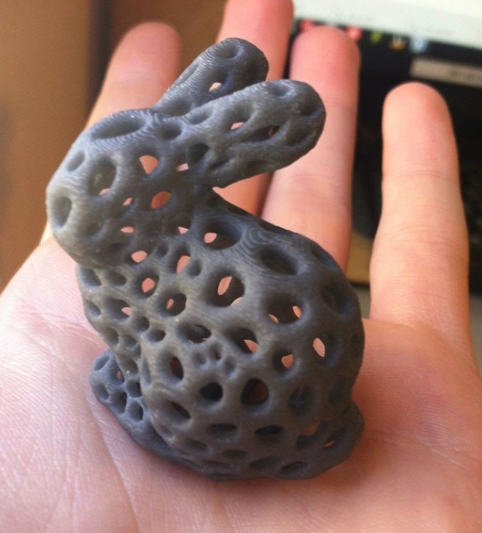

Slide 8
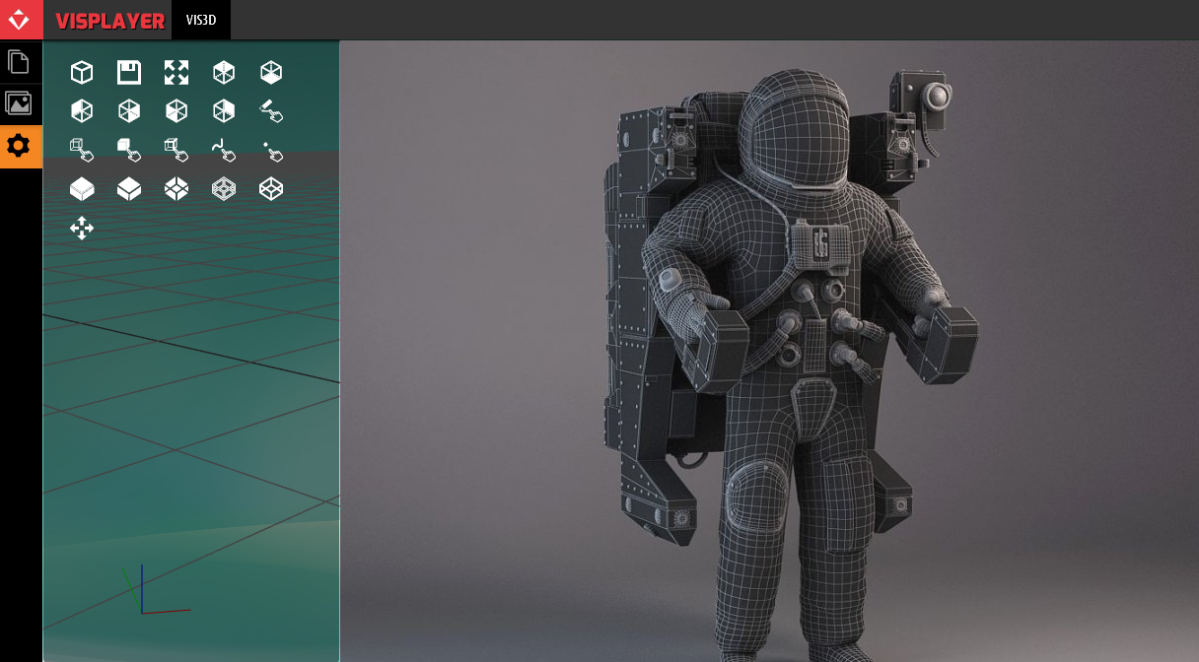

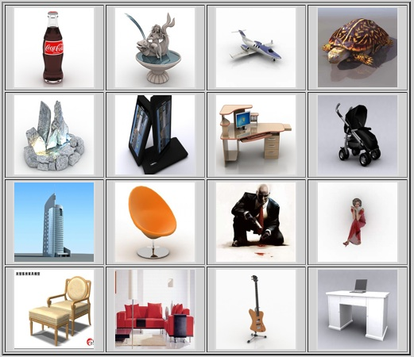
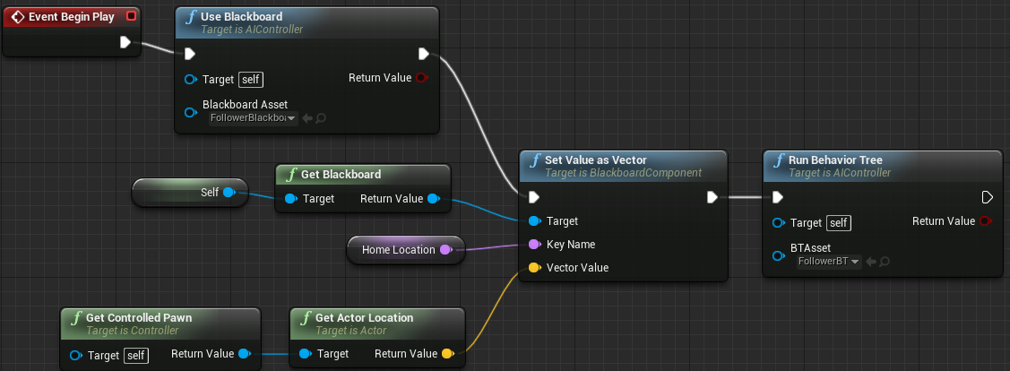
WHAT WE DO
Cloud Based
World easiest and most fun 3D design platform
Easy to Use
Mesh Modeling
3D Model Repository
Subscription
3D filter
3D Design & Printing
3D model database
3D Data AI Engine
Furniture
Personalized Items
Education
Automotive
Targeted Industry:
Tools
Toys

Slide 9
Funding Request
Asking $500,000 USD for 5% of the company

Slide 10
Go To Market Strategy
End User Subscription Pricing Model
Basic software is free to use
Partner Program
(3D printer manufacturers / resellers)
Silver: $200 per user for 12 months < 500 users annually
Pro version $19.99 / month (limited to print 10 models)
Pro Plus version $49.99 / month (unlimited)
Gold: $180 per user for 12 months between 500 and 1000 users annually
Platinum: $150 per user for 12 months > 1000 users annually
3D Filters
Price varies: $1.99~ $9999.99 depends on complexity
3D Models
Price varies: $0.99 ~ $9999.99 depends on model
Market Place for designers
(models and filters)
10% of sale price
Functionalities in version 1.0
Functionalities in version 2.0

Slide 11

Financial Projections
User projection
Goal is to have 20,000 user by end of 2019
E.g. $19.99 / month X 2,000 users (10% of all users) = $40,000 / month
Annual user target:
2020: 50,000 users (5,000 paid user)
2021: 100,000 users (10,000 paid user)
Partner program with 3D printer manufacturers / contractors
E.g. biggest 3D printer manufacturer sells 80,000 3D printers in 2016
Target 3 printer manufactures/contractors for 5,000 users in 2019
Estimate: $150 X 5,000 = $750,000 annually
Annual user target:
2020: 20,000
2021: 50,000
Total:
First Year (2019): $40,000 X 12 + $750,000 = $1,230,000
Second Year (2020): $19.99 X 5,000 + 20,000 X 150 = $3,100,000
Third Year (2021): $19.99 X 10,000 + 50,000 X 150 = $7,700,000

Slide 12
Financial Plan for Release 1.0
Items | Sub-Items |  | Units | Unit Price | Expenses
Rental | Office |  | 12 | $5,000 | $60,000
Assets | Workstation |  | 6 | $5,000 | $30,000
Salaries | Development | Full Stack Developer | 1 | $90,000 | $90,000
 |  | Geometry Algorithm Developer | 1 | $100,000 | $100,000
 |  | Product Developer | 1 | $80,000 | $80,000
 |  | Document Writer (second half of the year) | 1 | $50,000 | $50,000
 | Marketing | Marketing material | 1 | $60,000 | $60,000
Other expense | Cloud Rental | 9 month after Alfa release | 9 | $1000 | $9,000
 | Domain rental | 12 month | 12 | $50 | $600
 | travel | every month for marketing/meeting travel | 12 | $1000 | $12,000
 | Backoffice | payroll | 12 | $1000 | $12,000
 | Others
Release 1 Financial Needs |  |  |  |  | ~$500,000

Slide 13
Competitive Analysis
Software | Function | Geometry |  |  |  |  | Modeling |  |  |  | Manufacturing |  |  |  |  |  | Level | Price | System
 |  | Voxel | Mesh | Polygon | Subdivision | NURBS | Block | Laminate | Clay | Parametric | STL Viwer | STL Checker | STL Repair | STL Eidtor | Slicer | Hosting
123D Catch | Design |  | √ |  |  |  |  |  | √ |  |  |  |  |  |  |  | Beginner | Free | PC, Web, Mobile
123D Design | Design |  |  |  |  | √ |  |  |  | √ |  |  |  |  |  |  | Beginner | Free | PC, Web, Mobile
123D Make | Design |  | √ |  |  |  |  | √ |  |  |  |  |  |  |  |  | Beginner | Free | PC, Web, Mobile
123D Sculpt+ | Design |  | √ |  |  |  |  |  | √ |  |  |  |  |  |  |  | Beginner | Free | PC, Web, Mobile
3D View / Build | Design |  | √ |  |  |  |  |  | √ |  | √ |  |  |  |  |  | Beginner | Free | PC
3D-matic | Editinig |  | √ |  |  |  |  |  | √ |  | √ | √ | √ | √ | √ |  | Professional | Proprietary | PC
3DReshaper | Editinig |  | √ |  |  |  |  |  | √ |  | √ | √ | √ | √ |  |  | Professional | Proprietary | PC
3DTin | Design |  |  |  |  | √ |  |  |  | √ |  |  |  |  |  |  | Beginner | Free | Web
3D-Tool Free Viewer | Viewer |  | √ |  |  |  |  |  |  |  |  |  |  |  |  |  | Intermediate | € 60,000 | PC
Blender | Design |  |  |  | √ |  |  |  | √ | √ |  |  |  |  |  |  | Professional | Free | PC
ChronoSculpt | Design |  | √ |  |  |  |  |  | √ |  |  |  |  |  |  |  | Professional | $399 | PC
ClayTools | Design |  | √ |  |  |  |  |  | √ |  |  |  |  |  |  |  | Professional | Proprietary | PC
CraftWare | Printing |  |  |  |  |  |  |  |  |  | √ |  |  |  | √ | √ | Beginner | Free | PC
Cura | Printing |  |  |  |  |  |  |  |  |  | √ |  |  |  | √ | √ | Beginner | Free | PC
DesignX | Design |  | √ |  |  |  |  |  | √ |  |  |  |  |  |  |  | Professional | Proprietary | PC
Dreamcatcher | Design |  | √ |  |  |  |  |  |  |  |  |  |  |  |  |  | Beginner | Free | Web
Dynamo | Design |  |  |  |  | √ |  |  |  | √ |  |  |  |  |  |  | Professional | $300/y | PC
Form-Z Pro | Design |  | √ |  |  |  |  |  | √ |  |  |  |  |  |  |  | Professional | Proprietary | PC
FreeCAD | Design |  |  |  |  | √ |  |  |  | √ |  |  |  |  |  |  | Intermediate | Free | PC
Freeform Plus | Design |  | √ |  |  |  |  |  | √ |  |  |  |  |  |  |  | Professional | Proprietary | PC
Fusion 360 | Design |  | √ |  | √ | √ |  |  | √ | √ |  |  |  |  |  |  | Professional | Free, $300/y | PC
GrabCAD | Viewer |  | √ |  |  | √ |  |  |  |  |  |  |  |  |  |  | Beginner | Free | Web
Grasshopper | Design |  |  |  |  | √ |  |  |  | √ |  |  |  |  |  |  | Beginner | Free | PC
Inspire | Optimization |  | √ |  |  |  |  |  |  | √ |  |  |  |  |  |  | Professional | Proprietary | PC
Meshfix | Editinig |  | √ |  |  |  |  |  | √ |  |  |  | √ |  |  |  | Intermediate | Free | DOS
MeshLab | Editinig |  | √ |  |  |  |  |  | √ |  | √ | √ | √ | √ |  |  | Professional | Free | PC
Meshmixer | Editinig |  | √ |  |  |  |  |  | √ |  | √ | √ | √ | √ |  |  | Professional | Free | PC

Slide 14
Competitive Analysis
Highlights of industry movement:
Autodesk acquired 26
CAD design companies in the last 6 years
Lagoa raised 3 rounds in total of $8.4 M, was acquired by Autodesk on Nov 20, 2014 for $60M (Apr 2013 $1.6 M, Dec 2013 $5.3M, Feb 2014 $1.6M)
TinkerCAD raised $1 M in round 1 in Nov 2011, was acquired by Autodesk on May 5, 2013 for unknown amount
Software | Function | Geometry |  |  |  |  | Modeling |  |  |  | Manufacturing |  |  |  |  |  | Level | Price | System
 |  | Voxel | Mesh | Polygon | Subdivision | NURBS | Block | Laminate | Clay | Parametric | STL Viwer | STL Checker | STL Repair | STL Eidtor | Slicer | Hosting
Netfabb | Editinig |  | √ |  |  |  |  |  | √ |  | √ | √ | √ | √ | √ |  | Intermediate | € 1,500 | PC
OctoPrint | Printing |  |  |  |  |  |  |  |  |  |  |  |  |  |  | √ | Professional | Free | Web
OnShape |  |  |  |  |  | √ |  |  |  | √ |  |  |  |  |  |  | Professional | Free | Web
P3D.in | Viewer |  | √ |  |  |  |  |  |  |  |  |  |  |  |  |  | Beginner | Free | Web
ParaView | Viewer |  | √ |  |  |  |  |  |  |  |  |  |  |  |  |  | Professional | Free | PC, Web
PCL | Library |  | √ |  |  |  |  |  |  |  |  |  |  |  |  |  | Professional | Free, $300/y | PC
Recap |  |  | √ |  |  |  |  |  |  |  |  |  |  |  |  |  | Beginner | Free | Web
Remake | Editinig |  | √ |  |  |  |  |  | √ |  | √ | √ | √ | √ |  |  | Professional | Free, $300/y | PC
Repetier | Printing |  |  |  |  |  |  |  |  |  | √ |  |  |  | √ | √ | Intermediate | Free | PC, Web
Sculptris | Design |  |  |  | √ |  |  |  | √ |  |  |  |  |  |  |  | Beginner | Free | PC
Shapeshifter | Design |  | √ |  |  |  |  |  |  | √ |  |  |  |  |  |  | Beginner | Free | Web
Simplify3D | Printing |  |  |  |  |  |  |  |  |  | √ | √ | √ |  | √ | √ | Professional | $149 | PC
SketchFab | Viewer |  | √ |  |  |  |  |  |  |  |  |  |  |  |  |  | Beginner | Free | Web
SketchUp | Design |  |  | √ |  |  |  |  |  | √ |  |  |  |  |  |  | Intermediate | Free | PC
Slic3r | Printing |  |  |  |  |  |  |  |  |  | √ | √ | √ |  | √ |  | Professional | Free | PC
TinkerCAD | Design |  |  |  |  | √ |  |  |  | √ |  |  |  |  |  |  | Beginner | Free | Web
Vectary | Design |  |  |  | √ |  |  |  |  | √ |  |  |  |  |  |  | Intermediate | Free | Web
Visit | Viewer |  | √ |  |  |  |  |  |  |  |  |  |  |  |  |  | Professional | Free | PC
VTK | Library |  | √ |  |  |  |  |  |  |  |  |  |  |  |  |  | Professional | Free, $300/y | PC
VXmodel | Editinig |  | √ |  |  |  |  |  | √ |  | √ | √ | √ | √ |  |  | Professional | Proprietary | PC
Within | Optimization |  | √ |  |  |  |  |  |  | √ |  |  |  |  |  |  | Professional | Proprietary | PC

Slide 15
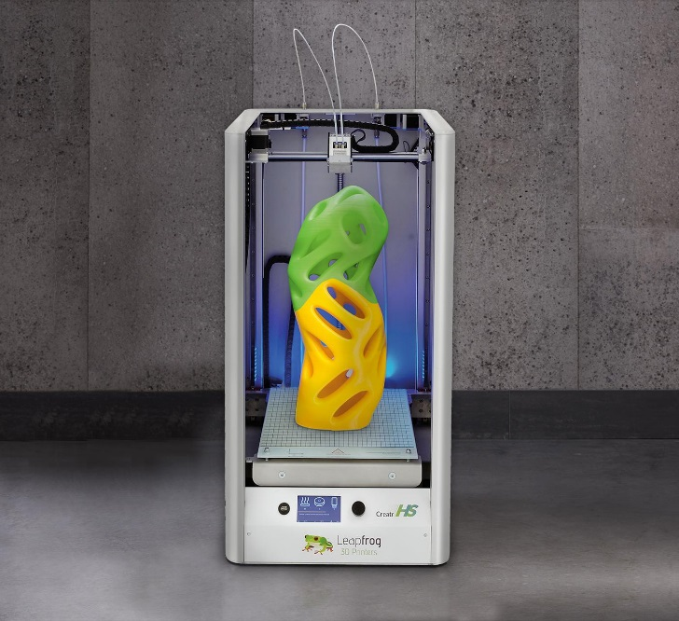
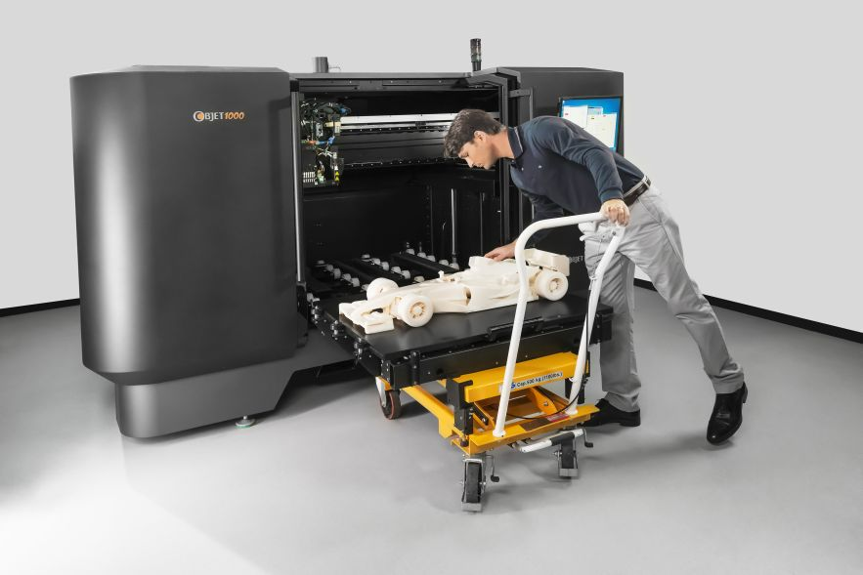
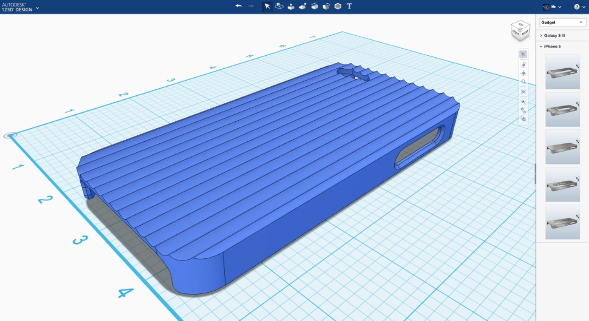
3D Printing Design Market
3D printer is becoming a commodity
300,000 3D printer sold in 2016
3D printers to grow triple digit percentage in next 5 - 10 years
Challenge: Easy-to-use 3D design tool is much needed
Other 3D image capture devices

Slide 16

3D Image Capture Devices
Largan Precision, one of the current suppliers for the iPhone's camera lens component, confirmed that it will ship lenses for 3D sensing modules in the second half of 2017, suggesting inclusion in the next-generation "iPhone 8." The confirmation comes from Largan CEO Adam Lin

Slide 17
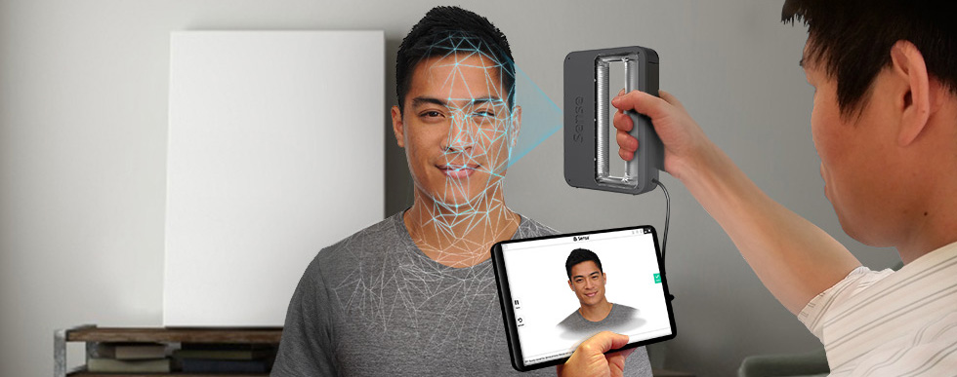
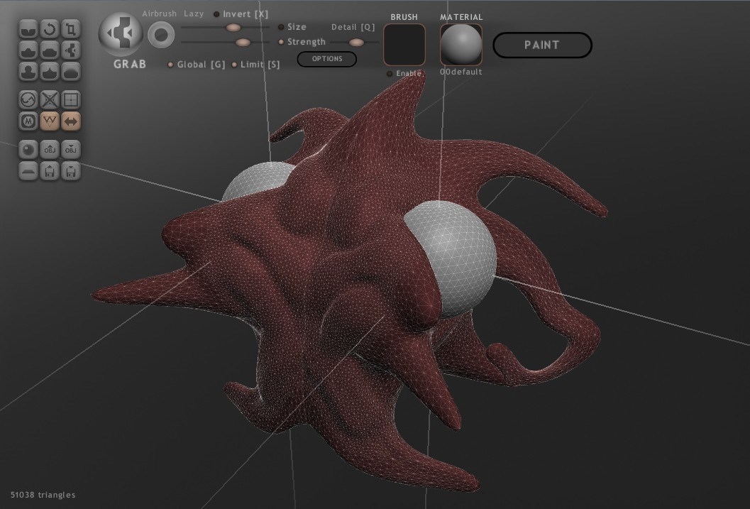

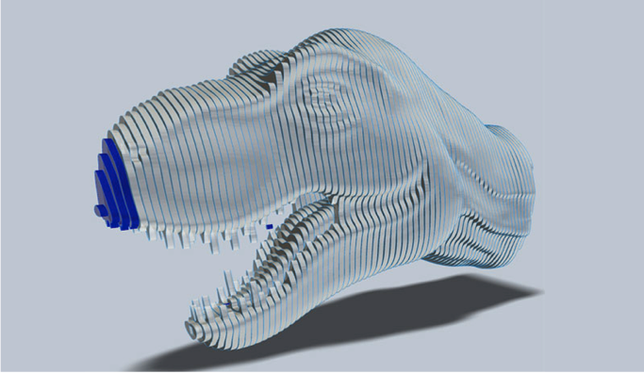

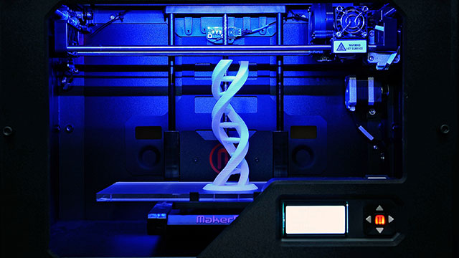
3D PRINTING Process
3D Scanning
(3D Model)
3D Model Editing
Mesh Repair
Mesh Editing
Mesh Validation
Modeling
Sculpturing
3D Preprocessing
3D Printing
Design for Manufacturing
G-Code Generation
Mesh Slicing

Slide 18
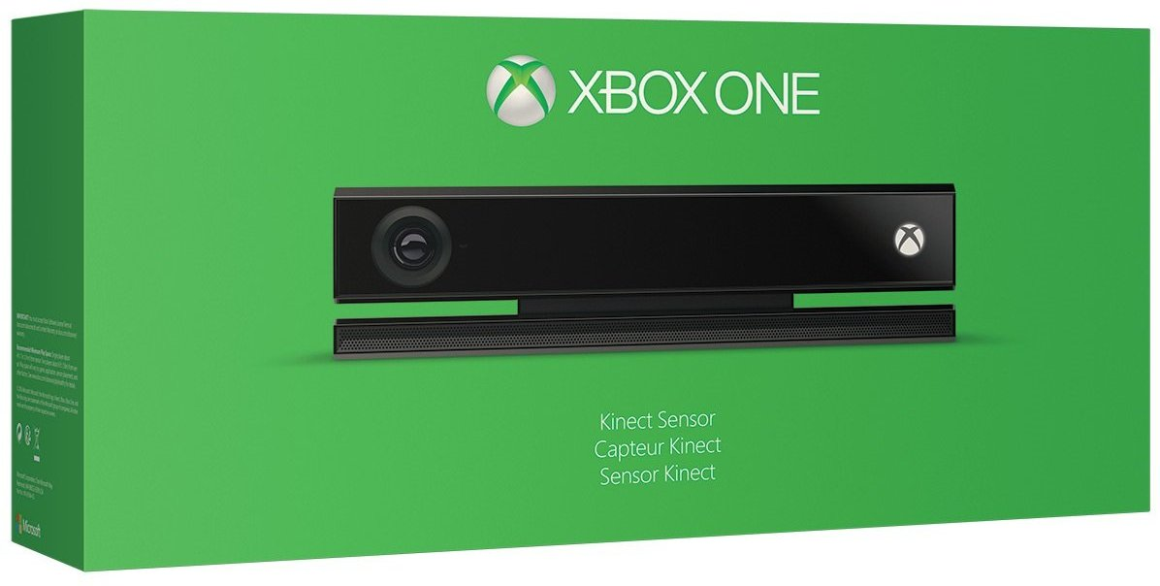
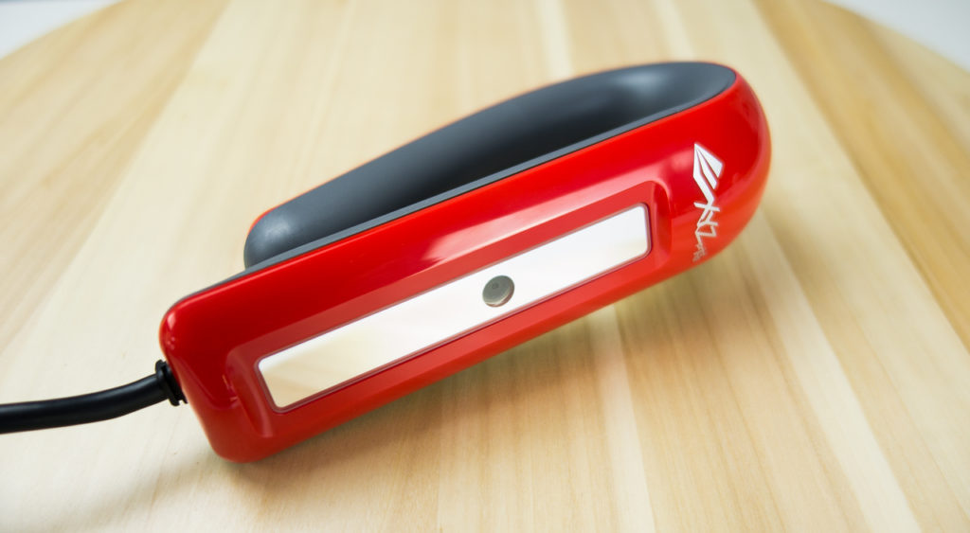
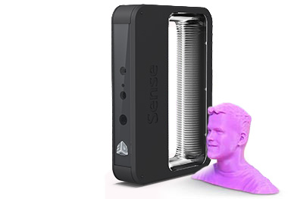
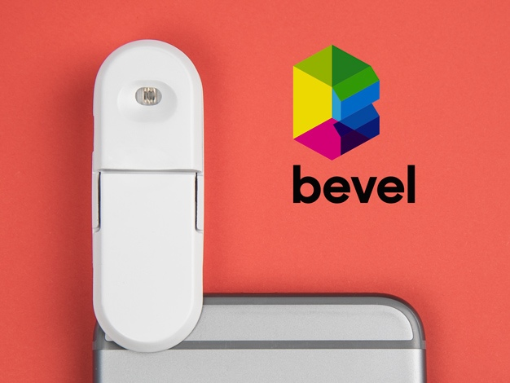
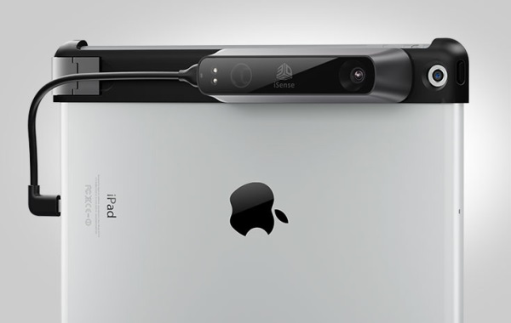
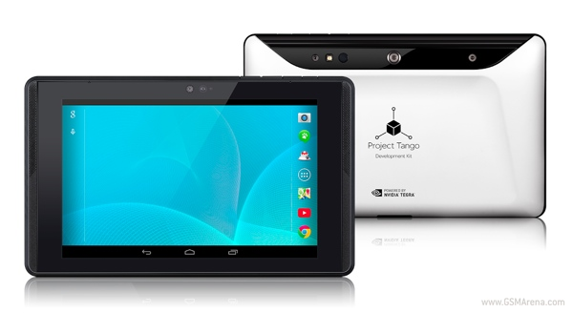
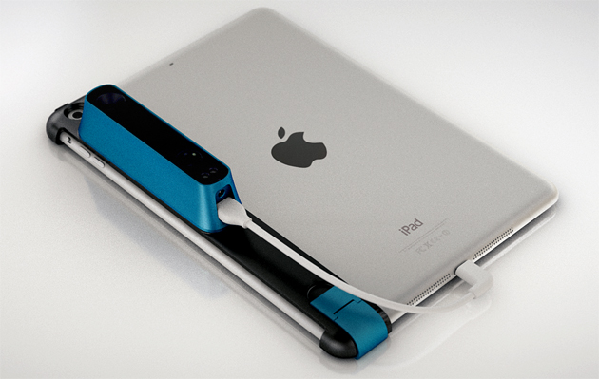
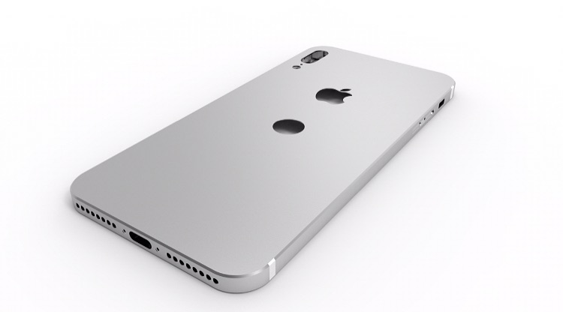
3D SCANNING Devices
XBOX ONE
XYZ 3D Scanner
XYZ 3D Scanner
Sense
Bevel Scanner
Bevel Scanner
iSense
Project Tango
Project Tango
Structure Sensor
iPhone
iPhone

Slide 19
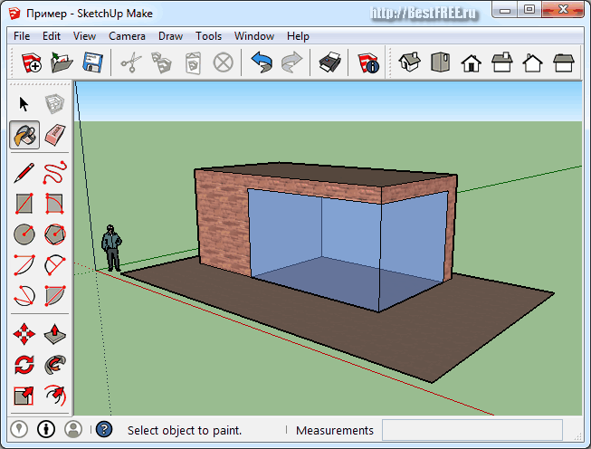
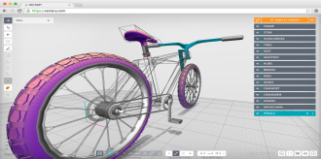
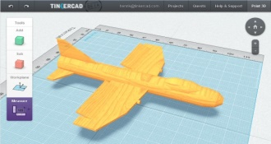
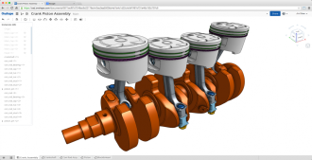
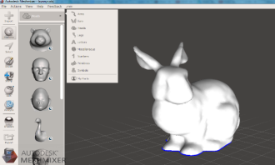
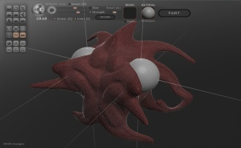
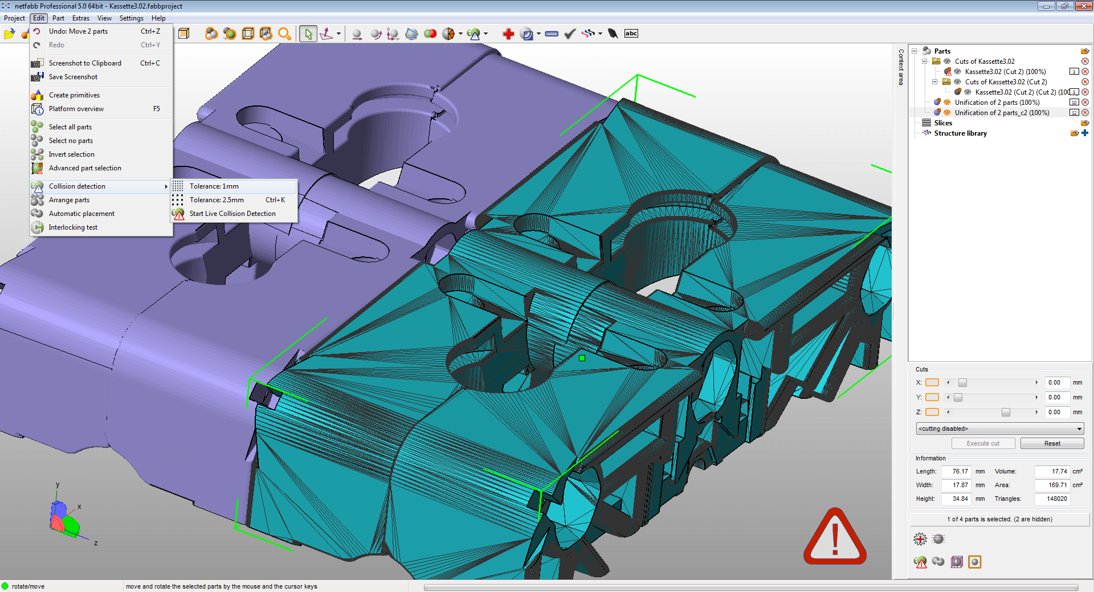
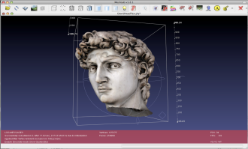
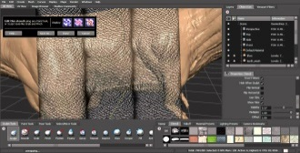
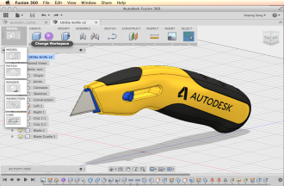
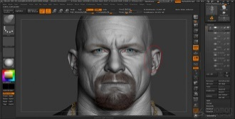
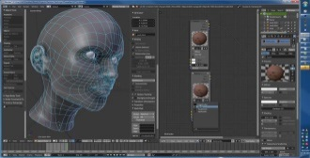
3D MODELING
Technology
MESH
SUBDIVISION
NURBS
Difficult to model
No industry standard editor
Hard to learn to model
Very expensive to buy
No model base to search/re-design
BLANK
Usability

Slide 20

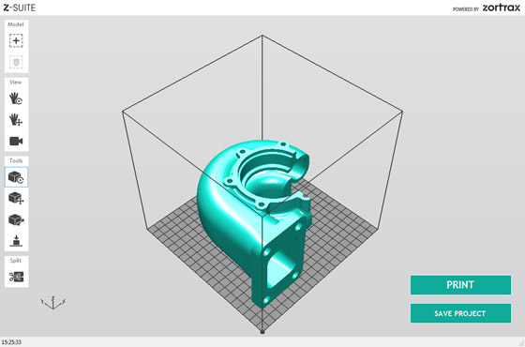
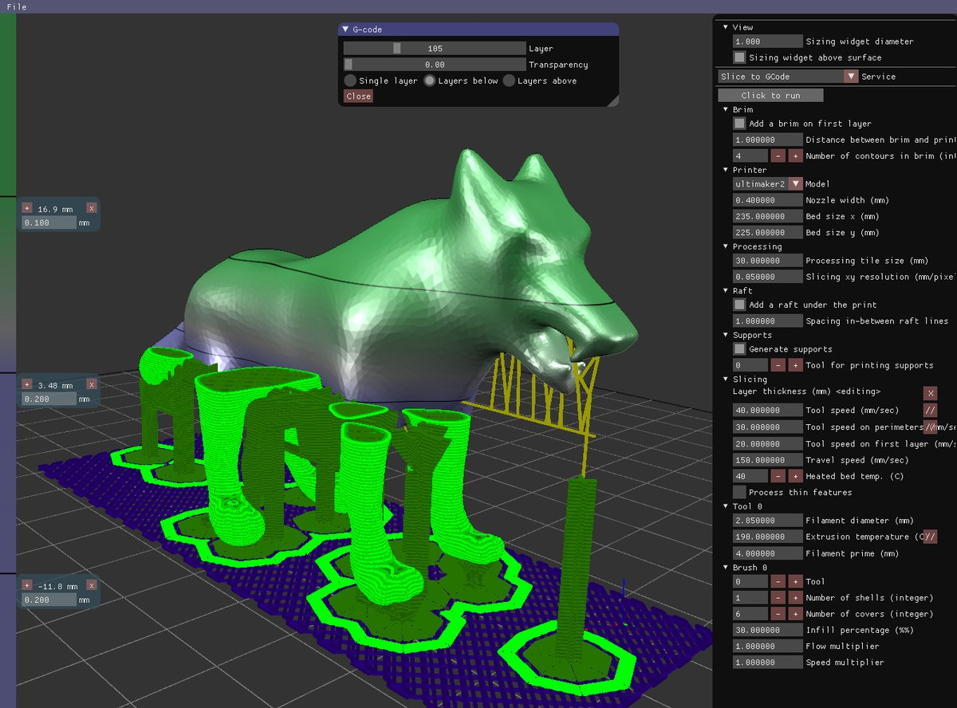
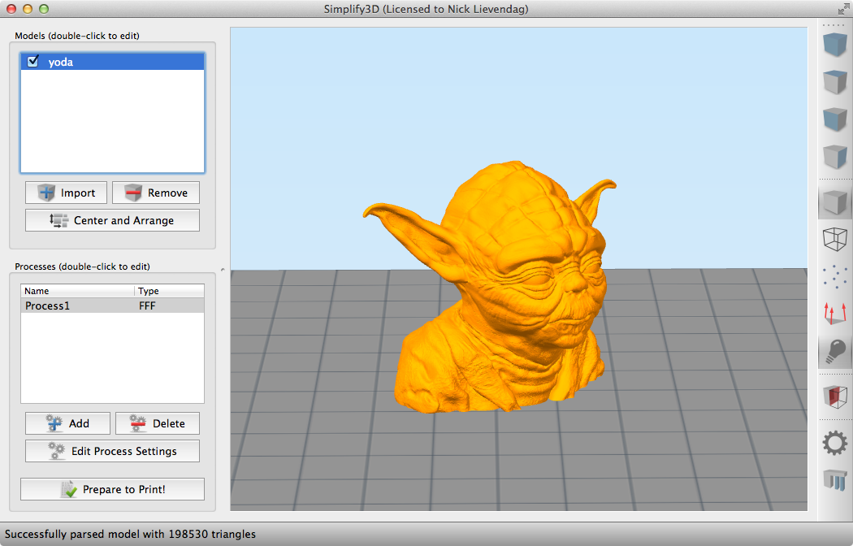
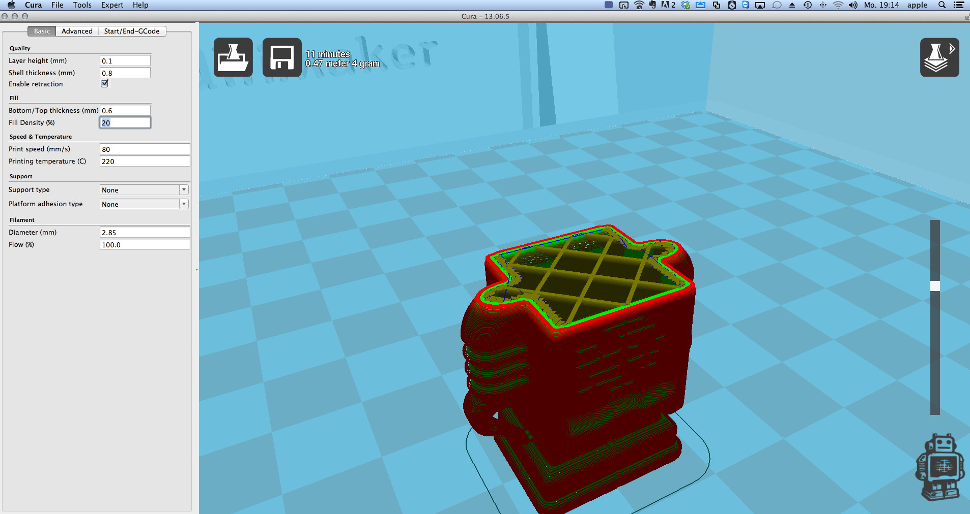
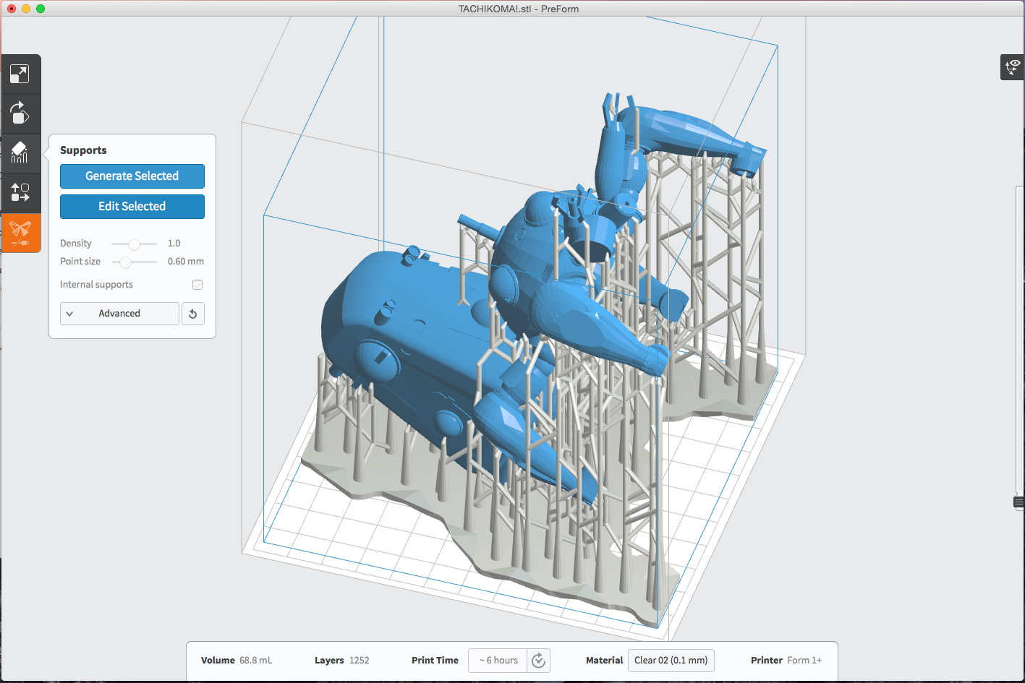
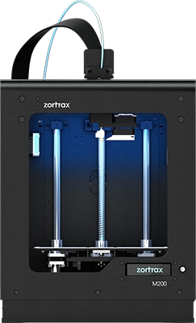
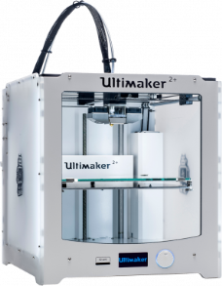
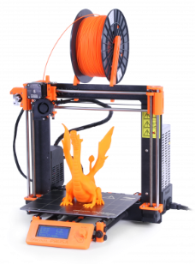









3D PREPROCESSING
Very Chaotic
3D printer manufacturing develops editing tool
No industry standard format
No knowledge base / lesson learned
...
...
...

Slide 21

3D PRINTING
There are over 500 3D printer manufacturers in the world
Scattered software design tool
High costs for 3D printer manufactures to develop and support their own design tool
Small 3D printer manufactures pay for manual 3D model editing
Ultimaker Ultimaker 2+
CEL Robox
Original Prusa i3 MK2
Zortrax M200
CraftBot PLUS
Printrbot Simple Metal
LulzBot TAZ 6
Replicator 5th Gen

Slide 22

Current Challenges
Design tools
Deep learning curve
Transition training from one CAD system to another takes 4-8 weeks, costs $20,000 - $500,000 based on number of users
eLearning online account costs ~$1,000 annually
Accessibility
Based on 20 yrs + technology
Pricing model
Cost
Traditional CAD system costs $10,000 - $30,000 per user + 20% - 30% annual maintenance fee
3D Printing
Standard tools and processes
3D model search ability
3D Data Intelligence (Data AI)
3D model recognition – model searching
3D processing template/module – knowledge reuse

Slide 23
Roadmap and timeline
70 | 95 | 25
115 | 135 | 50
2017 & 2018 Phase 1
First Go-Live
2019 Phase 2
Future
150 | 165 | 30
XXX
Product development
Continue product version 2.0 development
Continue PD
Alpha release
Beta release
XXX
Design team expansion
Language and region expansion
XXX
XXX
Marketing for Go-Live
Corporate with educational institutions
XXX
XXX
Corporate with 3D printer manufacturers
XXX
XXX
3D model database
XXX
3D model AI Engine
XXX
XXX
Goal is to have 20,000 user by end of 2019
XXX

Slide 24


Functionalities in each phase
Version 1.0 (end of 2018)
3D Framework
3D Model Repository
3D Reconstruction
3D Modifiers
Version 2.0 (end of 2019)
Visual Computing (3D processing template)
AI Engine
Search
Edit
Print

Slide 25
Organization Plan
Dong Zhao – CTO
Maureen Huber – CFO
Charles Wang – CEO
Geometry Algorithm Developer (to be hired in 2018)
Product Developer (to be hired in 2018)

Slide 26

DONG ZHAO
3D design programmer for over 20 years
Development Team lead and CAD design expert
Very Passionate in 3D design and development
WORK EXPERIENCE
Research Lead / Senior Software Developer
3D Industry Verterian (10+ Years)
CAD (Siemens PLM NX, SolidWorks, CATIA,...)
CAE (Fluent, Comsol, Forming Suite,...)
Skills in Geometry, Graphics and Computing
Geometry Processing
Computational Geometry
Computer Graphics
Computer Vision
Artificial Intelligence
EDUCATION
Ph.D. , Mechanical Engineering, University of Calgary
M.Sc, Automotive Engineering, Tongji University
B.Sc, Automotive Engineering, Tongji University

Slide 27
MAUREEN HUBER

Slide 28

CHARLES WANG
Over 12 years in CAD PLM Industry
Understanding of industry trends and customer needs
Energetic, passionate and spread-headed to revolutionize CAD PLM industry
WORK EXPERIENCE
Technical Account Manager (Siemens PLM)
Project/Program Manager (Siemens PLM)
Business Development Director (Rocket Software)
EDUCATION
MBA, Eli Board Business School (Michigan State University)
B.Sc, Computer Science (Wayne State University)

